Slide 1
IOT - IIT Escort Services
By
Ahmed Sayed
Zeshan Sayed

Slide 2
IOT
inter-networking of physical devices
collect and exchange data
Reliable when connectivity is involved

Slide 3
Problem?
Inappropriate system causing long queue
Long Waiting for student escort service
Queue ruins productive time
Less substitutes to travel after 7pm

Slide 4
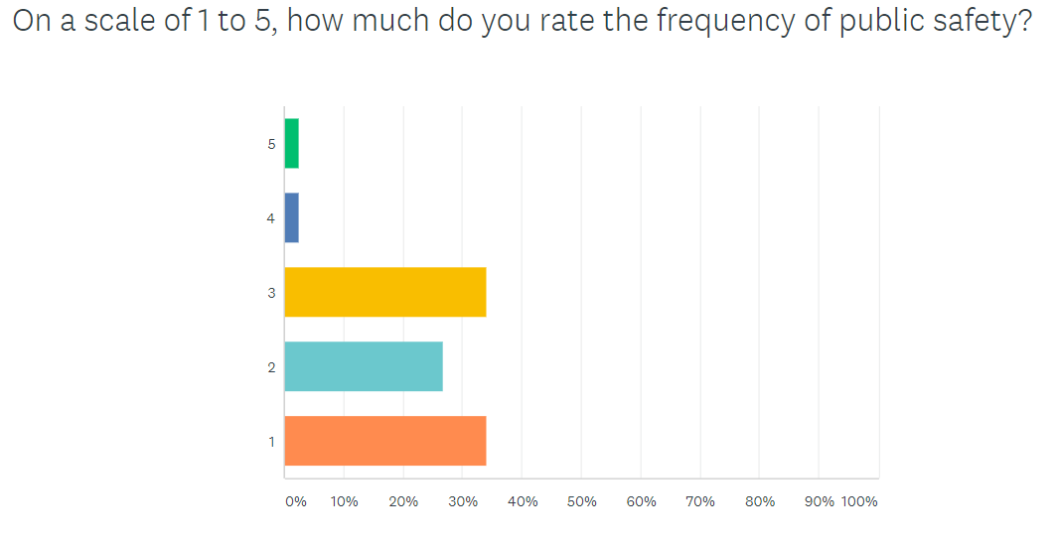
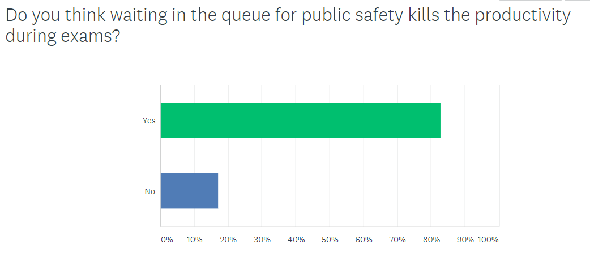
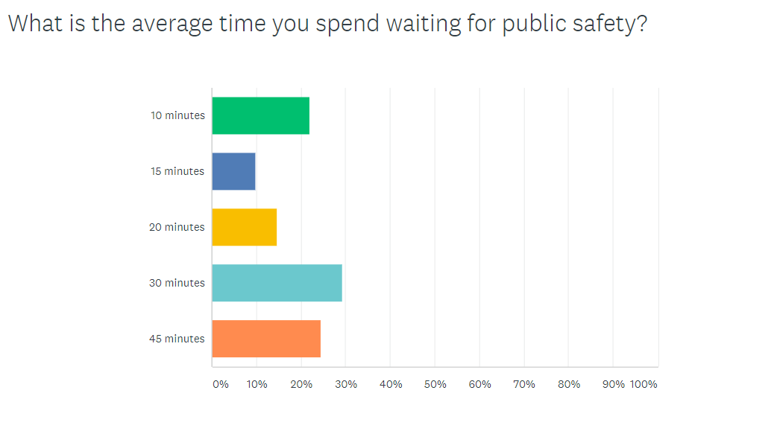
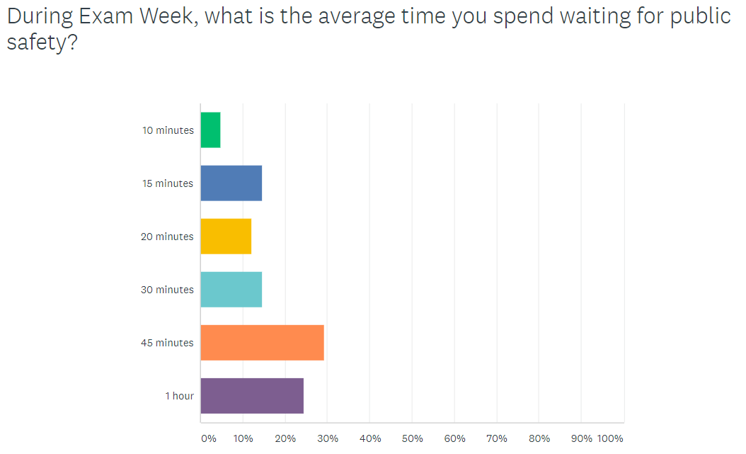

Slide 5
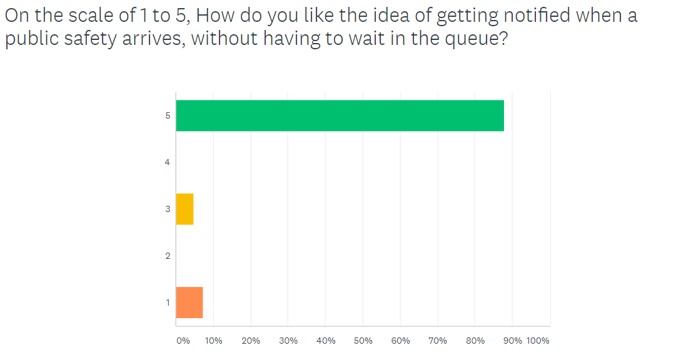
Solution
Proper management of queue
No longer waiting in the queue (physically)
Notifies students when escort service arrives
Improves productivity

Slide 6
When compared?
Escort Service System | Current | Proposed
Time Saving | No | Yes
Improving productivity of students | No | Yes
Notification Feature | No | Yes

Slide 7
Technology Used
Raspberry Pi
JavaScript
Nodejs
AWS Cloud RDS
Jquery

Slide 8




flOW

Slide 9

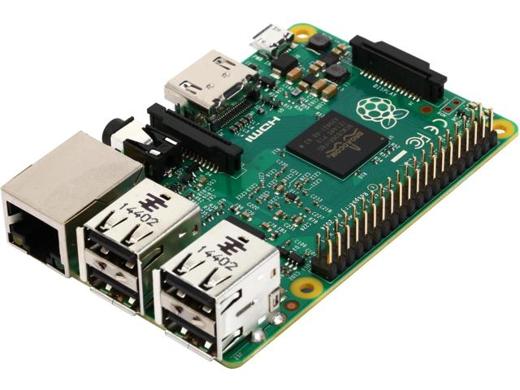


Slide 10
Demo
[{'name':'Ahmed Sayed', 'contact':'17737032688', 'hawkid':'A20388365'},
{'name':'Zeshan Sayed', 'contact':'16507978341', 'hawkid':'A20388365'},
{'name':'Tejas Manoj', 'contact':'13126782891', 'hawkid':'A20388365'},
{'name':'Mudassir Vavathar', 'contact':'17737876305', 'hawkid':'A20388365'},
{'name':'Divyank', 'contact':'12016260675', 'hawkid':'A20388365'}];

Slide 11
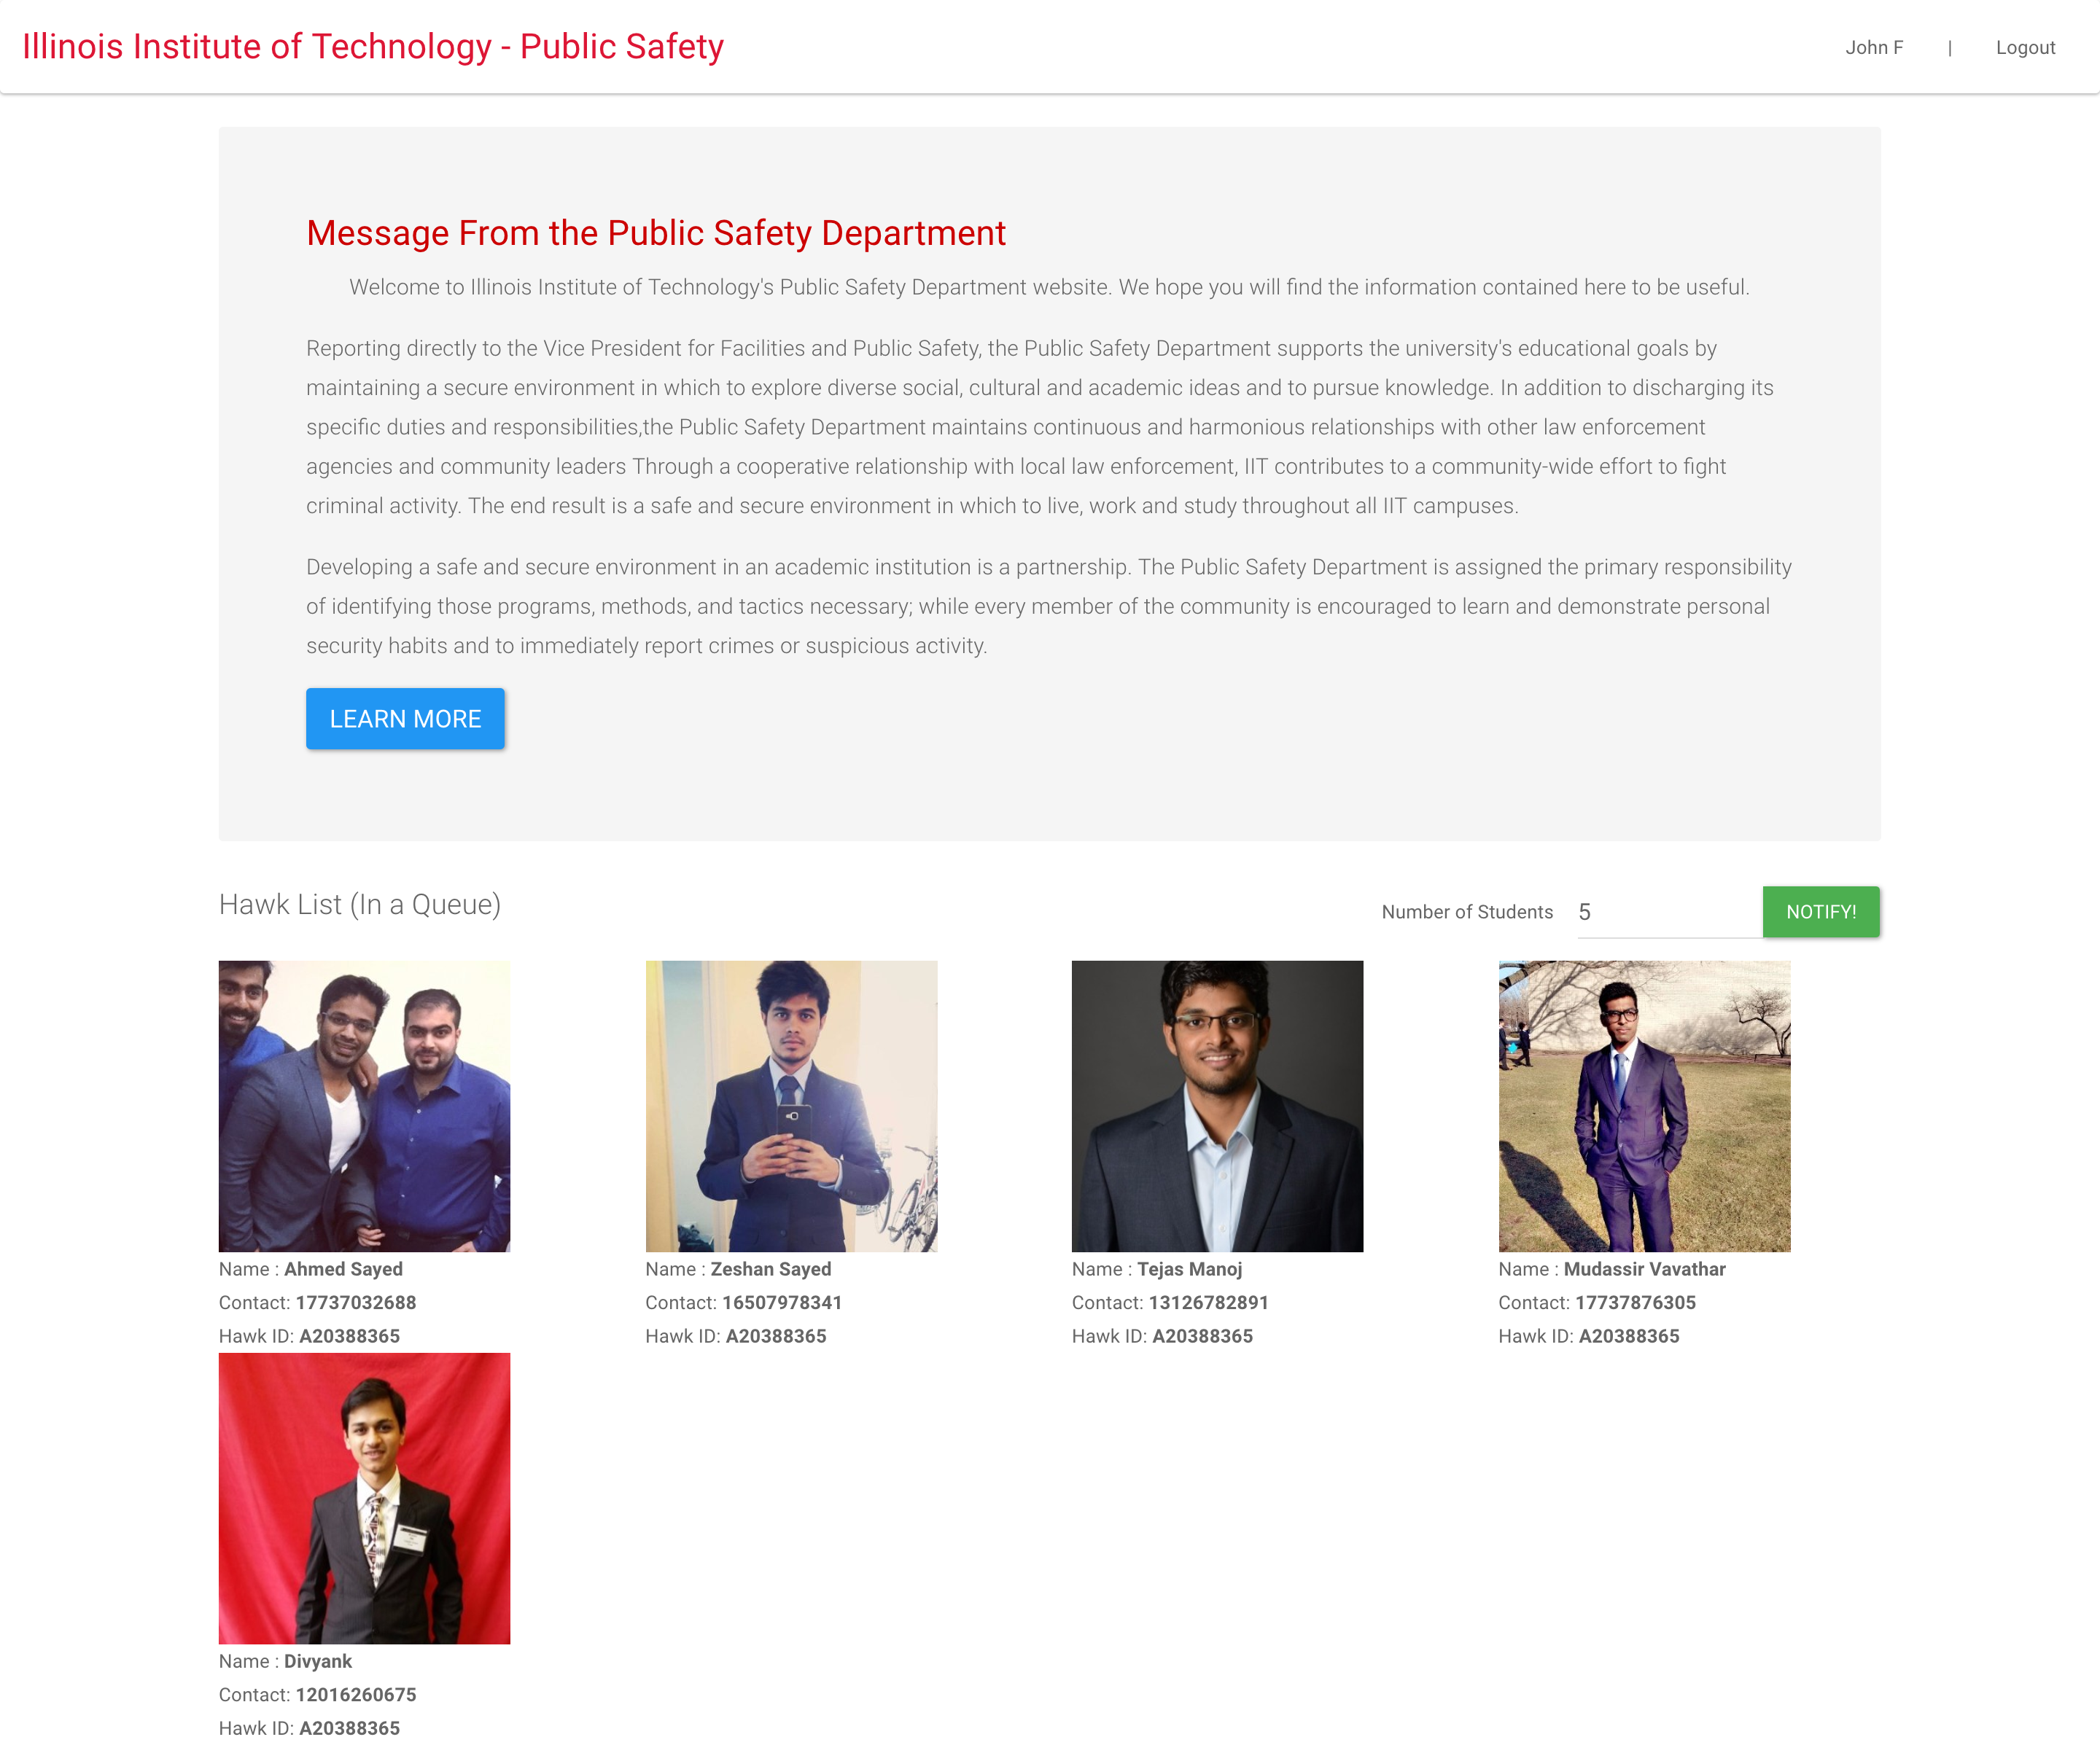

Slide 12
Questions ?

Slide 13
Thank You

